Slide 1
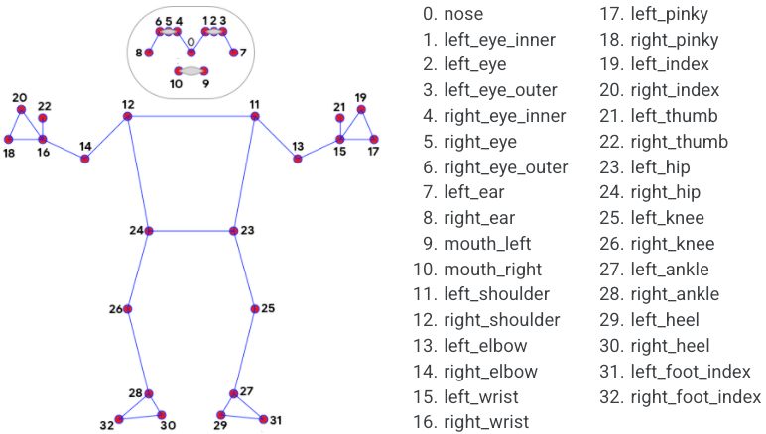
SESSION 12
Keypoint &
Pose Estimation
From keypoints to skeletons — understanding body pose with MediaPipe & YOLO
Body joint detection — real-time skeleton tracking
TYPE
COVERS
Theory + Hands-On
MediaPipe + YOLOv8-Pose
Phase 3 — Core CV Tasks | Week 6

Slide 2
Today's Agenda
ROADMAP
What are Keypoints?
Top-Down vs Bottom-Up
1
2
Joints, landmarks, and why they matter
Two fundamental approaches to multi-person pose
Landscape of Models
MediaPipe Pose — Deep Dive
3
4
OpenPose, HRNet, and more
BlazePose architecture & 33 landmarks
YOLOv8-Pose — Deep Dive
Real-World Applications
5
6
Single-stage detection + keypoints
Fitness, sports, healthcare, AR, gaming & more
Session 12 | Keypoint & Pose Estimation | Phase 3 — Core CV Tasks

Slide 3
Recap: CV Task Hierarchy — Where Pose Fits
RECAP
Classification
Detection
Segmentation
Pose Estimation
"What is in
the image?"
"What &
where?"
"Which class
owns each pixel?"
"Where are
the joints?"
OUTPUT
OUTPUT
OUTPUT
OUTPUT
One label per image
Box + label per object
Per-pixel masks
Keypoints + skeleton
Pose estimation adds spatial understanding of body structure — from bounding boxes to articulated skeletons
Session 12 | Keypoint & Pose Estimation | Phase 3 — Core CV Tasks

Slide 4
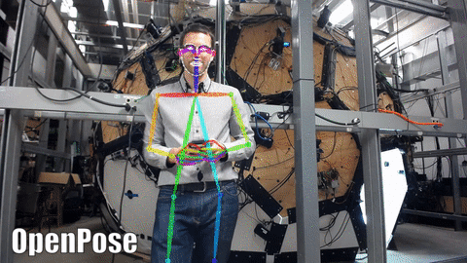
What are Keypoints?
DEFINITION
Semantic Anchor Points
Specific, meaningful locations on an object (e.g., joints on a body, corners of a face) that can be consistently identified across different images and poses.
Input
RGB image (H × W × 3)
OpenPose multi-person output — body + hand + face
Output
(x, y, confidence) per keypoint
Skeleton = Keypoints + Edges
Nodes:
Joint locations (shoulder, elbow, wrist...)
Edges:
Limb connections (shoulder→elbow, elbow→wrist...)
Together they form an articulated body model
Format
COCO: 17 keypoints × 3 values
Connection
Keypoints linked into a skeleton graph
Session 12 | Keypoint & Pose Estimation | Phase 3 — Core CV Tasks

Slide 5
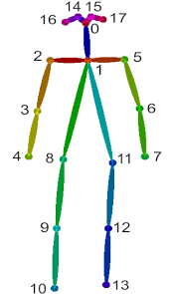
COCO 17 Keypoint Topology
STANDARD
The Industry Standard
COCO Skeleton Topology
COCO defines 17 body keypoints used by most modern pose estimation models, including YOLOv8-pose, HRNet, and OpenPose (COCO variant).
Head (0-4)
Upper Body (5-10)
0 Nose
1 Left Eye
2 Right Eye
3 Left Ear
4 Right Ear
5 Left Shoulder
6 Right Shoulder
7 Left Elbow
8 Right Elbow
9 Left Wrist
10 Right Wrist
Lower Body (11-16)
11 Left Hip | 12 Right Hip | 13 Left Knee | 14 Right Knee | 15 Left Ankle | 16 Right Ankle
Session 12 | Keypoint & Pose Estimation | Phase 3 — Core CV Tasks

Slide 6
How Keypoints are Detected — Heatmap Regression
INTUITION
Input
Image
→
CNN
Backbone
→
K Heatmaps
(one per joint)
→
argmax
per map
→
Keypoint
Coordinates
How It Works
Why Heatmaps?
1. A CNN extracts feature maps from the input image
2. For each keypoint, a separate heatmap is generated — a 2D probability map where brighter = higher confidence
3. The peak location (argmax) of each heatmap gives the (x, y) coordinate of that keypoint
4. Sub-pixel refinement and confidence thresholding produce the final skeleton
Direct regression of (x, y) coordinates is fragile — small errors compound. Heatmaps let the network express uncertainty spatially, making training more stable and predictions more accurate.
Direct Regression
Heatmap Regression
Predict (x,y) directly
Harder to train
Less accurate
Predict probability map
Easier to optimise
State-of-the-art accuracy
Session 12 | Keypoint & Pose Estimation | Phase 3 — Core CV Tasks

Slide 7
PART 1
Two Paradigms for
Multi-Person Pose
Top-Down vs Bottom-Up — the two fundamental design choices

Slide 8
Top-Down vs Bottom-Up Approaches
PARADIGMS
Top-Down
Person First
Bottom-Up
Joints First
1. Detect each person — (bounding box)
1. Detect ALL keypoints — in the entire image
2. Crop & resize — each person
2. Group keypoints into — individual people (PAFs)
3. Run pose model — on each crop
3. Assemble skeletons — from grouped joints
Pros: Higher accuracy per person, easier to handle occlusion
Cons: Speed scales with number of people (N × inference)
Used by: HRNet, SimpleBaseline, ViTPose
Pros: Speed independent of number of people — constant time
Cons: Harder to handle crowded scenes, lower per-person accuracy
Used by: OpenPose, Lightweight OpenPose, DEKR
Session 12 | Keypoint & Pose Estimation | Phase 3 — Core CV Tasks

Slide 9
Pose Estimation Model Landscape
OVERVIEW
Model
Year
Approach
Keypoints
Speed
Key Differentiator
OpenPose
2017
Bottom-Up
Up to 135
~3 FPS (GPU)
First real-time multi-person; body + hands + face
HRNet
2019
Top-Down
17
~0.16 FPS (GPU)
Highest accuracy; maintains high-res features throughout
MediaPipe
2020
Top-Down
33
30+ FPS (CPU)
Mobile-first; BlazePose architecture; 3D landmarks
YOLOv8-Pose
2023
Single-Stage
17
100+ FPS (GPU)
Detection + pose in one pass; best speed-accuracy
For this course, we focus on MediaPipe (mobile/lightweight) and YOLOv8-Pose (production speed + accuracy)
Session 12 | Keypoint & Pose Estimation | Phase 3 — Core CV Tasks

Slide 10
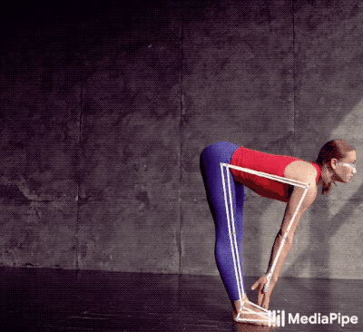
PART 2
MediaPipe Pose
Deep Dive
Google's on-device, real-time 33-landmark body tracking

Slide 11
MediaPipe BlazePose — Architecture
DEEP DIVE
Two-Stage Pipeline
Stage 1: Person Detector
Stage 2: Landmark Model
Based on BlazeFace SSD architecture
Input: RGB image (224 × 224 × 3)
Output: Bounding box + 2 virtual keypoints
Virtual keypoints (Vitruvian Man inspired):
• Hip midpoint (body centre)
• Circumscribing circle radius + rotation
Only runs on first frame, then tracks
MobileNetV2-based CNN backbone
Input: Cropped person (256 × 256)
Output: 33 landmarks × 5 values each
Per landmark: (x, y, z, visibility, presence)
• x, y: normalised image coordinates
• z: depth relative to hip midpoint
• visibility: is the joint in frame?
• presence: does the joint exist?
Key Advantage
Runs at 30+ FPS on mobile CPUs without GPU. The detector only runs when the person is lost, making subsequent frames extremely fast. Provides 3D landmarks (x, y, z) — rare for lightweight models.
Session 12 | Keypoint & Pose Estimation | Phase 3 — Core CV Tasks

Slide 12
MediaPipe — 33 Landmarks vs COCO 17
LANDMARKS
16 Extra Landmarks over COCO
Face
Mouth (left/right), inner/outer eyes
Hands
Pinky, index, thumb per hand
Feet
MediaPipe's 33-point body topology (source: Google)
Heel, foot index per foot
Why This Matters
Extra hand and foot landmarks enable gesture recognition, sign language detection, and gait analysis — tasks impossible with just 17 keypoints.
Session 12 | Keypoint & Pose Estimation | Phase 3 — Core CV Tasks

Slide 13
PART 3
YOLOv8-Pose
Deep Dive
Single-stage detection and pose — one model, one forward pass

Slide 14
YOLOv8-Pose — Architecture
DEEP DIVE
Input
Image
→
CSPDarknet53
Backbone
→
PANet
Neck (FPN)
→
Detection
Head
→
Pose
Head
One forward pass outputs bounding boxes AND keypoints simultaneously
Backbone: CSPDarknet53
Neck: PANet (FPN)
Heads: Detect + Pose
Cross-Stage Partial connections extract rich multi-scale features from the input image. Efficient architecture balances depth and computation.
Path Aggregation Network fuses features across multiple scales. Enables detection of both small and large persons in the same image.
Detection head predicts bounding boxes + class. Pose head predicts 17 keypoints × 3 (x, y, confidence) per detected person.
Key innovation: pose estimation as a branch of object detection — no separate person detector needed
Session 12 | Keypoint & Pose Estimation | Phase 3 — Core CV Tasks

Slide 15
YOLOv8-Pose — Model Variants & Performance
MODELS
Model
Params
FLOPs
mAP (50-95)
Speed (ms)
Best For
YOLOv8n-pose
3.3M
9.2B
50.4
~1.5ms
Edge / Mobile
YOLOv8s-pose
11.6M
30.2B
60.0
~2.5ms
Balanced
YOLOv8m-pose
26.4M
81.0B
65.0
~5.0ms
Production
YOLOv8l-pose
44.4M
168.6B
67.6
~8.0ms
High Accuracy
YOLOv8x-pose
69.4M
263.2B
69.2
~12ms
Maximum Accuracy
Speed-Accuracy Tradeoff
Nano (n) runs on edge devices at 600+ FPS on GPU. Extra-large (x) achieves near-HRNet accuracy. In practice, the medium (m) variant offers the best balance for real-time production use.
Session 12 | Keypoint & Pose Estimation | Phase 3 — Core CV Tasks

Slide 16
MediaPipe vs YOLOv8-Pose — When to Use What
COMPARISON
Dimension
MediaPipe Pose
YOLOv8-Pose
Architecture
Two-stage (detect → landmark)
Single-stage (detect + pose)
Keypoints
33 (body + face + hands + feet)
17 (COCO body standard)
3D Support
Yes (x, y, z per landmark)
No (2D only)
Multi-Person
Single person only (by default)
Multi-person native
Speed (CPU)
30+ FPS (optimised for mobile)
~5-15 FPS (depends on variant)
Speed (GPU)
N/A (designed for CPU)
100-600+ FPS
Best Use Case
Mobile apps, fitness, single user
Surveillance, sports, multi-person
MediaPipe = best for single-person mobile apps | YOLOv8-Pose = best for multi-person production systems
Session 12 | Keypoint & Pose Estimation | Phase 3 — Core CV Tasks

Slide 17
PART 4
Real-World
Applications
Pose estimation is transforming fitness, sports, healthcare, gaming & more

Slide 18
Where Pose Estimation is Used
APPLICATIONS
1
Fitness & Training
2
Sports Analytics
3
Healthcare / Rehab
AI-powered rep counting, form correction, virtual coaching apps
Athlete biomechanics, performance tracking, referee assist
Physical therapy tracking, gait analysis, posture correction
4
AR & VR
5
Gaming
6
Surveillance & Retail
Full-body tracking for avatars, gesture-based interaction
Motion capture for character animation, gesture-based controls
Action recognition, fall detection, cashierless stores
Session 12 | Keypoint & Pose Estimation | Phase 3 — Core CV Tasks

Slide 19
Evaluation Metrics for Pose Estimation
METRICS
OKS (Object Keypoint Similarity)
The pose equivalent of IoU. Measures how close predicted keypoints are to ground truth, normalised by person scale and per-joint tolerance. Range: 0 (no match) to 1 (perfect).
AP (Average Precision @ OKS)
Computed like detection mAP but using OKS instead of IoU. AP@0.50:0.95 is the primary COCO metric — averaged across 10 OKS thresholds.
PCK (Percentage of Correct Keypoints)
A keypoint is 'correct' if it falls within a threshold distance of ground truth (e.g., PCK@0.5 = within 50% of head segment length). Simpler but less standard than OKS.
OKS-based AP is the gold standard — used by COCO, PoseTrack, and all major benchmarks
Session 12 | Keypoint & Pose Estimation | Phase 3 — Core CV Tasks

Slide 20
Challenges in Pose Estimation
CHALLENGES
Occlusion
Crowded Scenes
Body parts hidden behind objects or other people — the model must infer invisible joints from context
Many overlapping people make keypoint-to-person grouping extremely difficult (especially for bottom-up)
Unusual Poses
Small / Distant People
Yoga, gymnastics, dance — extreme articulations outside typical training distributions
Low resolution makes keypoints ambiguous; multi-scale feature fusion (FPN) helps
Motion Blur / Low Light
Self-Similarity
Fast movement or poor lighting degrades feature quality — temporal models and augmentation help
Left vs right confusion — the model may swap symmetric joints (left/right elbow)
Modern models address these with data augmentation, multi-scale features, and temporal smoothing in video
Session 12 | Keypoint & Pose Estimation | Phase 3 — Core CV Tasks

Slide 21
Coming Up — Hands-On Practice
NEXT
In the Notebook We Will...
1
MediaPipe Pose on images & webcam
Detect 33 landmarks, draw skeleton overlays, extract joint coordinates
2
YOLOv8-Pose inference
Run YOLOv8n-pose on images and video, compare multi-person detection
3
Visualise & compare outputs
Side-by-side skeleton rendering, keypoint confidence analysis
4
Build a simple angle calculator
Compute joint angles (e.g., elbow, knee) from keypoint coordinates
Session 12 | Keypoint & Pose Estimation | Phase 3 — Core CV Tasks

Slide 22

Key Takeaways
SUMMARY
Keypoints are semantic anchor points (joints) — a skeleton is keypoints + edges connecting them
Heatmap regression is the dominant paradigm — predict a 2D probability map per joint, then take the peak
Top-down (detect person → estimate pose) is more accurate; bottom-up (detect all joints → group) is faster for crowds
MediaPipe excels on mobile with 33 3D landmarks and CPU-only inference at 30+ FPS
YOLOv8-Pose combines detection and pose in one pass — ideal for multi-person, production-grade systems
Applications span fitness, sports analytics, healthcare, AR/VR, gaming, and surveillance
Next session: OCR & Text Detection — from pixels to readable text
Session 12 | Keypoint & Pose Estimation | Phase 3 — Core CV Tasks

